Slide 1
UNICORNS COMPANIES
ANALYSIS SUMMARY

Slide 3
UNICORNS INDUSTRIES STARTING WITH THE HIGHEST INDUSTRY
Fintech | 224
Internet software & services | 205
E-commerce & direct-to-consumer | 111
Health | 74
Artificial intelligence | 73
Other | 58
Supply chain, logistics, & delivery | 57
Cybersecurity | 50
Data management & analytics | 41
Mobile & telecommunications | 38
Hardware | 34
Auto & transportation | 31
Edtech | 28
Consumer & retail | 25
Travel | 14
Artificial Intelligence | 11

Slide 4
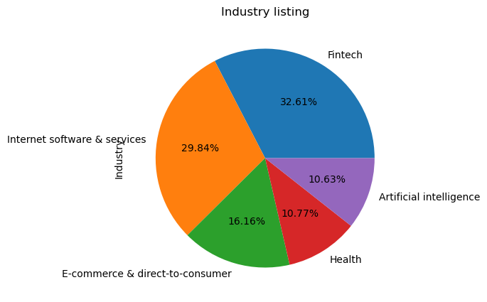
Visualizing the top five industry by a pie chart percentage

Slide 5
INSIGHTS & RECOMMENDATIONS
Unicorns has a total of 1074 companies
United States has the most Unicorns with a total of 562
. San Francisco is a industry hub city topping up with 152
. North America has the majority of industries with a total of 589
Africa has the least of industries with a total of 3
8. The Unicorns top five industry :-
Fintech - 224
Internet software & services - 205
E-commerce & direct-to-consumer - 111
Health - 74
Artificial intelligence - 73
Recommendations
I would recommend the following:-
Unicorns to try and invest more in Africa and increase their coverage and probably expand on their revenue.
Unicorns can also try venture into Agribusiness and maximum their profit.
The fact that Fintech industry is the majority, Unicorns should try and balance in other industries just to ensure they are also doing well.
The world is going into Artificial Intelligence Ella and I am of the opinion they expand the industry.
Health industry is of important as it gives back to the community and I am of the opinion they invest more in it.
6. The Unicorns top 5 companies :-
Bytedance
Spacex
Shein
Stripe
Klarna
7. The Unicorns 5 bottom companies:-
Zhaogang
Zhuan Zhuan
Zihaigio
Zopa
Swift

